Slide 1





Partners
1

Slide 2

Air Transport Hall of Fame – What?
A new vehicle to recognize and honor outstanding leaders who have made a lasting positive impact on the
global air transport industry
2

Slide 3
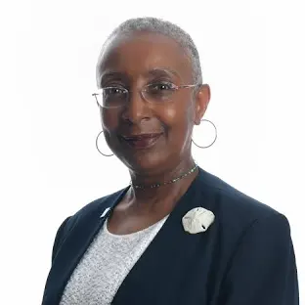
Air Transport Hall of Fame – Why?
“While individual countries, aviation associations and regions have their recognition programs for stellar, ground-breaking performance advancing the reach and proficiency of commercial aviation, this effort attempts to recognize such talent at the global level”
Angela Gittens, President, Hermes – Air Transport Organisation
3

Slide 4
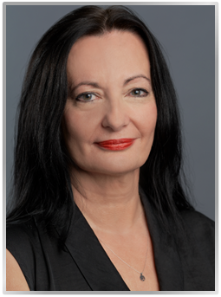
Air Transport Hall of Fame – Why?
“The Hall of Fame is not just a collection of biographies; it is a testament to the enduring human spirit and the relentless pursuit of excellence. It is a reminder that the sky is not the limit, but merely the beginning of what we can achieve when we dare to dream and when we pursue this dream to reality.”
Ioanna Papadopoulou, Director, Communications & Marketing, Athens International Airport
© 20
4

Slide 5
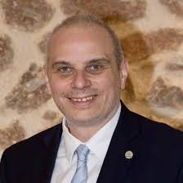
Air Transport Hall of Fame – Why?
“One of the mandates of Hermes is to promote and present to the wider public the work of aviation and its contribution to the economic, political and social development around the world.”
Dr. Kostas Iatrou, Director General, Hermes – Air Transport Organisation
© 20
5

Slide 6
Air Transport Hall of Fame – Why?
“At Korn Ferry, our expertise at Korn Ferry is in leadership and, as such, there is no higher honor for us than to recognize those who ‘led the way’ in establishing civil aviation for our collective benefit.”
Michael Bell – Leader, Civil Aviation Practice, Korn Ferry
© 20
6

Slide 7

Criteria for Selection
All nominees for the Hall of Fame are evaluated against the following criteria
“An inductee to the Air Transport Hall of Fame should have made a major, positive, and lasting impact on the commercial air transport industry at the global level. In so doing, his/her leadership and actions fundamentally changed and improved the industry for stakeholders. The inductee can be living or deceased.”
Every Inductee will be bestowed with the Deadalus Award
© 20
7

Slide 8
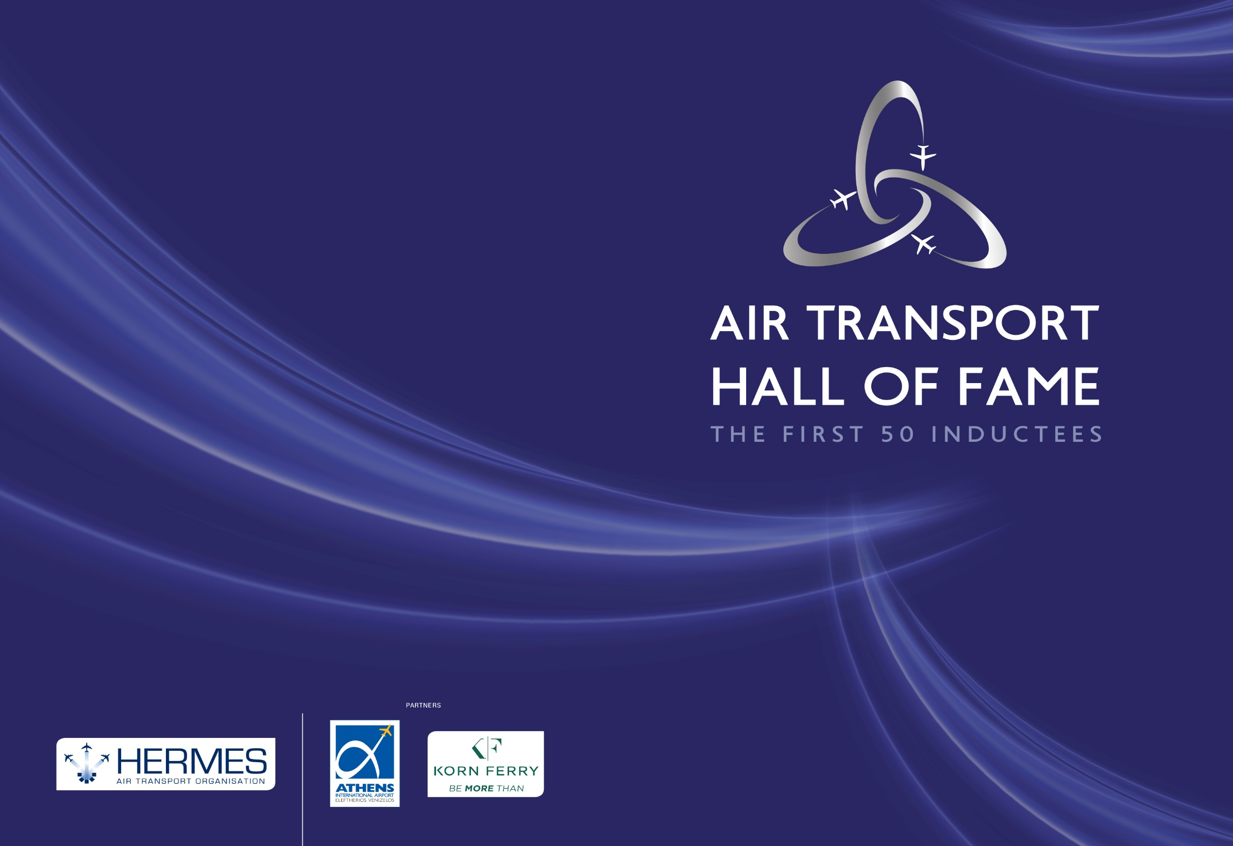
© 20
8

Slide 9
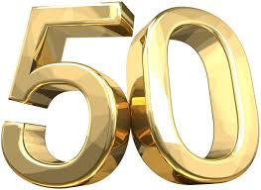
Initial Group of Inductees
50 in total, so as to create an initial “critical mass” of inductees
  All meet the criteria:
                “What the 50 inductees all have in common, and what we are recognizing through their induction to the Hall, is that they were bold and visionary leaders who changed the worlds they lived in as well as that we all share today.” (Angela Gittens)
            “One might think that it was hard work to identify 50 worthy inaugural inductees for the Hall. In truth, our challenge was the opposite – it was hard work to keep it to 50, with many others worthy of consideration.” (Michael Bell)
Effectively represent most of the “pioneers” of the commercial air transport industry
Wide international distribution
Diverse group, both gender and ethnic
As an initial group, restricted to those who are deceased, with posthumous recognition
© 20
9

Slide 10


Nomination and Selection Process
Nominations prepared by the Nomination Committee, with primary research conducted by Korn Ferry:
      Hermes President Angela Gittens
      Immediate past President of ICAO, Dr Bernard Aliu
      Hermes Director General, Dr Kostas Iatrou
      Korn Ferry Civil Aviation Practice Leader, Michael Bell (Chair)
Reviewed and Voted on by the Air Transport Hall of Fame Membership Committee:
      Initially, the Hermes Board of Directors
      Eventually, once a sufficient number of living inductees are on board, a group selected from among the members
Each year:
      ~8-10 nominations will be submitted
      ~4-5 new inductees will be selected (5 maximum)
© 20
10

Slide 11
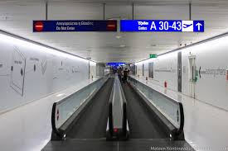

The Hall of Fame – Coming to Life
Brochure with inductees
Website
Projection of Inductee Photos and Summary Profiles in the Satellite Terminal Connector at Athens International Airport
© 20
11

Slide 12


Slide 13
© 20
13

